Slide 1
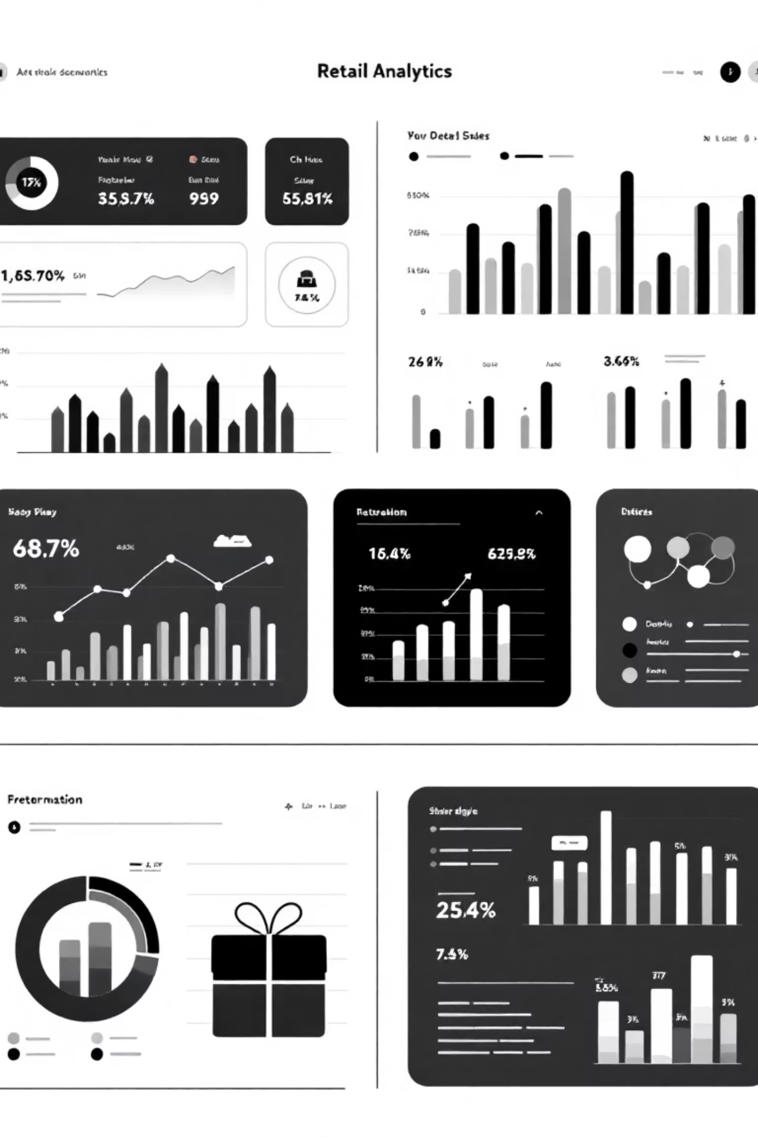
Customer Shopping Behavior Analysis
Analyzing 3,900 purchases to uncover spending patterns, customer segments, and strategic opportunities

Slide 2
Dataset Overview
3,900
18
50
25
Total Purchases
Data Points
Locations
Products
Transactions analyzed across all categories
Features tracked per customer
Geographic coverage
Unique items purchased
Key Features
Data Quality
Customer demographics
37 missing values in Review Rating column, imputed using median by category
Purchase details & amounts
Shopping behavior patterns
Cleaned and standardized for analysis
Review ratings & shipping

Slide 3
Data Preparation Process
01
02
03
Data Loading & Exploration
Missing Data Handling
Feature Engineering
Imported dataset, checked structure and summary statistics
Imputed Review Rating nulls using category medians
Created age_group and purchase_frequency_days columns
04
05
Data Consistency
Database Integration
Dropped redundant promo_code_used column
Loaded cleaned data into PostgreSQL for SQL analysis

Slide 4

Revenue & Customer Insights
Gender Revenue Gap
Smart Discount Users
Shipping Preferences
Male customers: $157,890
839 customers used discounts but spent above average
Express: $60.48 avg
Female customers: $75,191
Standard: $58.46 avg
Males generate 2x more revenue
High-value shoppers seeking deals
Premium shipping = higher spend
Top-Rated Products
Subscription Status
Gloves (3.86)
Subscribers: 1,053 customers, $59.49 avg spend
Sandals (3.84)
Non-subscribers: 2,847 customers, $59.87 avg spend
Boots (3.82)
Hat (3.80)
Skirt (3.78)

Slide 5



Customer Segmentation
New
1
83
2
Returning
701
3
Loyal
3,116
80% of customers are loyal, representing the foundation of revenue
Discount-Dependent Products
Repeat Buyers
Age Group Revenue
Hat (50%)
Customers with 5+ purchases:
Young Adult: $62,143
Sneakers (49.66%)
Non-subscribers: 2,518
Middle-aged: $59,197
Coat (49.07%)
Sweater (48.17%)
Subscribers: 958
Adult: $55,978
Pants (47.37%)
Opportunity to convert repeat buyers
Senior: $55,763

Slide 6
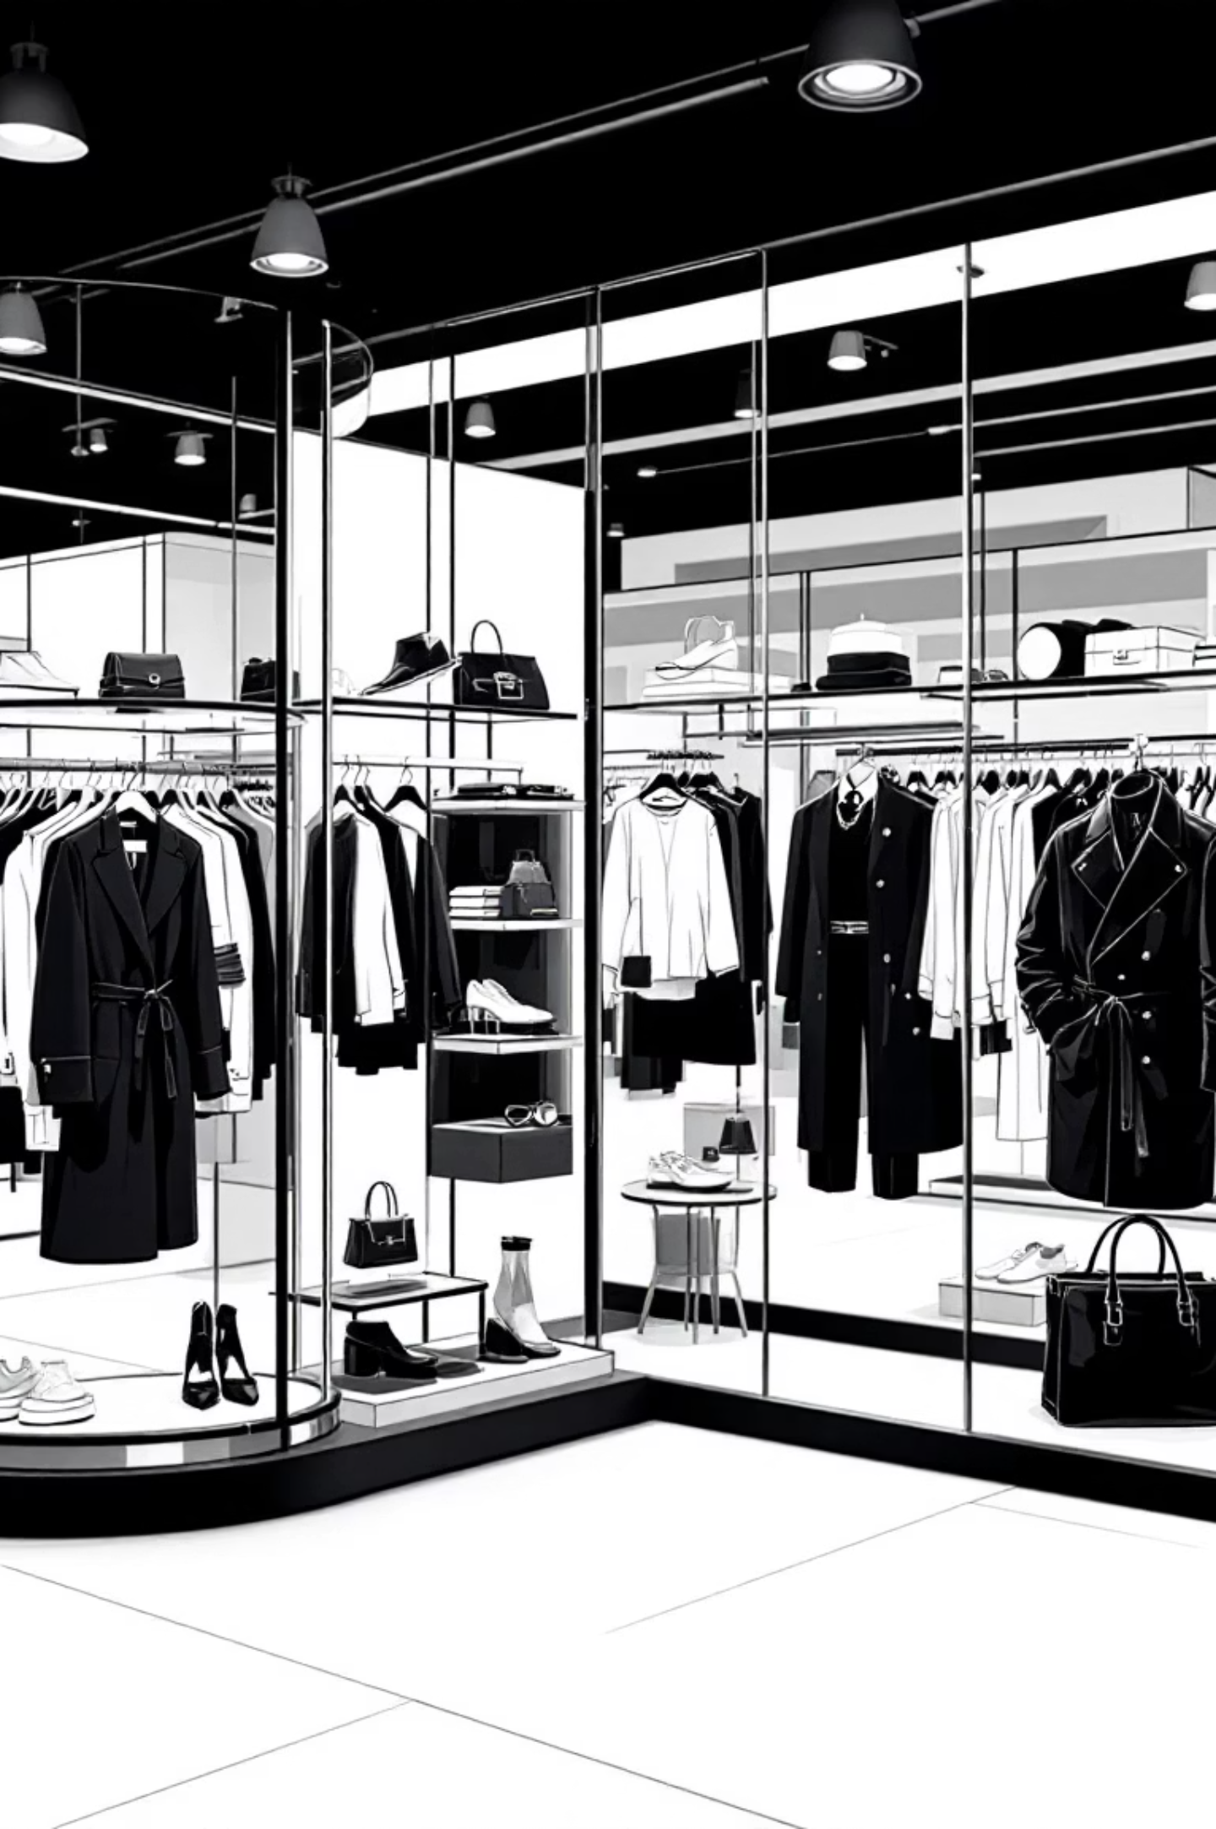
Top Products by Category
Accessories
1
Jewelry (171 orders)
Sunglasses (161)
Belt (161)
Clothing
2
Blouse (171 orders)
Pants (171)
Shirt (169)
Footwear
3
Sandals (160 orders)
Shoes (150)
Sneakers (145)
Outerwear
4
Jacket (163 orders)
Coat (161)

Slide 7

Strategic Recommendations
Boost Subscriptions
Loyalty Programs
Review Discount Policy
Promote exclusive benefits to convert 2,518 repeat buyers into subscribers
Reward repeat buyers to strengthen the 80% loyal customer base
Balance sales boosts with margin control for discount-dependent products
Product Positioning
Targeted Marketing
Highlight top-rated items (Gloves, Sandals, Boots) in marketing campaigns
Focus on Young Adults and express-shipping users for maximum revenue impact

